Slide 1
Azure AI Agent Orchestration
EMEA AI GBB X-Pod

Slide 2
Single Azure AI Agent with Foundry SDK
Simplest scenario possible
A user with a runtime calls the Azure AI Agent (Foundry Agent) on Azure
In this instance, the Foundry Agent can only do LLM calls
No tools or plugins are provided

Slide 3



Single Azure AI Agent with Foundry SDK
Azure
(Azure AI Agent Service)
Foundry Agent
User

Slide 4
Single Azure AI Agent with Semantic Kernel
A simple scenario with one Foundry Agent and one Semantic Kernel Agent
The Semantic Kernel agent “wraps around” around the Foundry agent using the class ’AzureAIAgent’
A user with an executing runtime calls the SK agent which in turns calls the Foundry agent
In this instance, the agents can only do LLM calls
No tools or plugins are provided

Slide 5
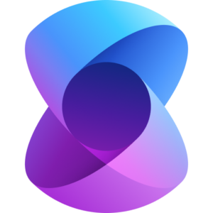

Semantic Kernel Classes – Creating Foundry Agent
Agent
client.agents.create_agent()
agent_definition
AzureAIAgent
SK Foundry Agent Wrapper
Foundry SDK
Semantic Kernel

Slide 6
Single Azure AI Agent with Semantic Kernel
Local or Azure
Azure
(Azure AI Agent Service)
SK
Agent
Foundry Agent
User
SK Agents can be created as wrappers around the Azure AI Agent with the class AzureAIAgent

Slide 7
Azure AI Connected Agents
One Foundry Agent – the orchestrator - is “connected” to other Foundry Agents
A user with an executing runtime calls the orchestrator Foundry agent which in turns calls one or more Foundry agents
In this instance, the agents can only do LLM calls
Tools or plugins can be provided

Slide 8



Azure AI Connected Agents
Azure
(Azure AI Agent Service)
Orchestrator Agent
User
Foundry Agent
Foundry Agent
Foundry Agent
Grounding with Bing
Logic Apps Tool
OpenAPI Tool

Slide 9
Azure AI Agent with Semantic Kernel and Plugins
A scenario with one Foundry Agent and one Semantic Kernel Agent
The Semantic Kernel agent “wraps around” around the Foundry agent using the class ’AzureAIAgent’
A user with an executing runtime calls the SK agent which in turns calls the Foundry agent
In this instance, tools are provided to the SK agent.
The Foundry Agent decides on which tool to call, and the SK agent executes them

Slide 10
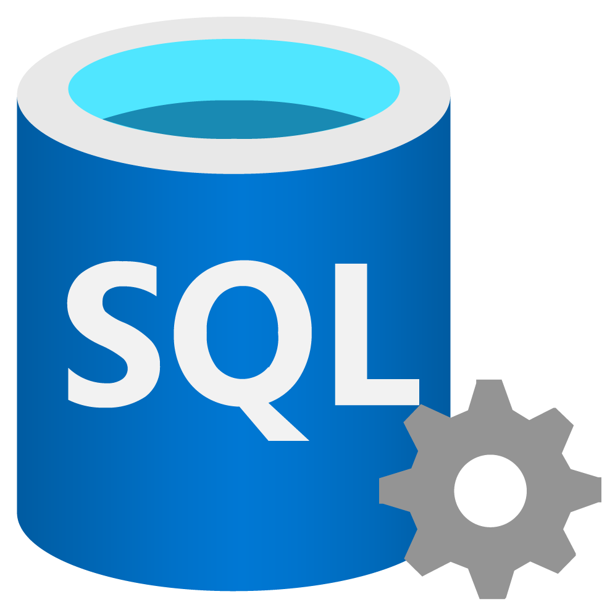
Azure AI Agent with Semantic Kernel and Plugins
Local or Azure
Azure
(Azure AI Agent Service)
Plugins are executed in the same compute as SK –
after the Foundry Agent function call
SK
Agent
Foundry Agent
User
The Foundry Agent decides on which plugin to call using Function Calling
Other Domain
SK Plugin calls
SQL Server to retrieve data

Slide 11
Azure AI Agent with Semantic Kernel and Azure Tools
A scenario with one Foundry Agent and one Semantic Kernel Agent
The Semantic Kernel agent “wraps around” around the Foundry agent using the class ’AzureAIAgent’
A user with an executing runtime calls the SK agent which in turns calls the Foundry agent
In this instance, tools are provided to the Foundry agent.
The Foundry Agent decides on which tool to call, and then proceeds to execute them in Azure

Slide 12
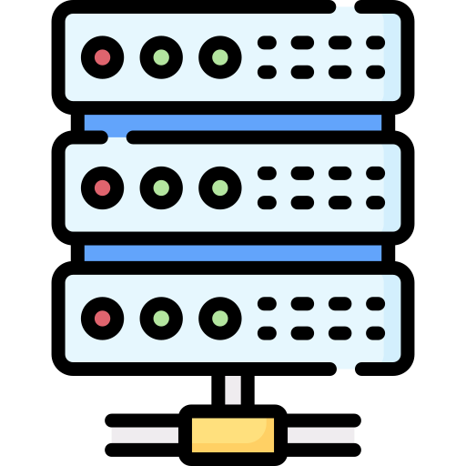
Azure AI Agent with Semantic Kernel and Azure Tools
Local or Azure
Azure
(Azure AI Agent Service)
Logic Apps Tool
SK
Agent
Foundry Agent
User
Plugins run in the same compute as SK –
after the Foundry Agent function call
Grounding with Bing
OpenAPI Tool
Internet
Web Service

Slide 13
Azure AI Agent with SK and Code-defined Logic Apps
A scenario with one Foundry Agent and one Semantic Kernel Agent
The Semantic Kernel agent “wraps around” around the Foundry agent using the class ’AzureAIAgent’
A user with an executing runtime calls the SK agent which in turns calls the Foundry agent
In this instance, a Logic App tool is provided to the Foundry agent
The Foundry Agent decides on whether to call the Logic App tool, and then notifies the SK agent. The SK agent then remotely calls the Logic App tool

Slide 14
Azure AI Agent with SK and Code-defined Logic Apps
Local or Azure
Azure
(Azure AI Agent Service)
Plugins are executed in the same compute as SK –
after the Foundry Agent function call
SK
Agent
Foundry Agent
User
The Foundry Agent decides on which plugin to call using Function Calling
Other Domain
SK Plugin calls
SQL Server to retrieve data
Logic Apps Tool

Slide 15
Azure AI Agents with SK Sequential Orchestrator
A scenario with multiple Foundry Agents and Semantic Kernel agents
The Semantic Kernel agents “wrap around” around the Foundry agents
We also define an SK orchestrator (not an agent)
A user with an executing runtime calls the SK orchestrator
The SK orchestrator calls the wrapping SK agents which in turn call their respective Foundry agents
In this instance, the SK orchestrator calls the agents sequentially

Slide 16
Azure AI Agents with SK Sequential Orchestrator
Local or Azure
Azure
(Azure AI Agent Service)
SK
Agent
Foundry Agent
Orchestrator SK Agent
SK
Agent
Foundry Agent
User
Plugins run in the same compute as SK –
after the Foundry Agent function call
SK
Agent
Foundry Agent

Slide 17
Azure AI Agents with SK Concurrent Orchestrator
A scenario with multiple Foundry Agents and Semantic Kernel agents
The Semantic Kernel agents “wrap around” around the Foundry agents
We also define an SK orchestrator (not an agent)
A user with an executing runtime calls the SK orchestrator
The SK orchestrator calls the wrapping SK agents which in turn call their respective Foundry agents
In this instance, the SK orchestrator calls the agents concurrently

Slide 18
Azure AI Agents with SK Concurrent Orchestrator
Local or Azure
Azure
(Azure AI Agent Service)
SK
Agent
Foundry Agent
Orchestrator SK Agent
SK
Agent
Foundry Agent
User
Plugins run in the same compute as SK –
after the Foundry Agent function call
SK
Agent
Foundry Agent

Slide 19
Azure AI Agents with SK Orchestrators
A scenario with multiple Foundry Agents and Semantic Kernel agents
The Semantic Kernel agents “wrap around” around the Foundry agents
We also define an SK orchestrator. In this example, this could be a Magentic Orchestrator with ledger orchestration, or just a regular orchestrator
A user with an executing runtime calls the SK orchestrator
The SK orchestrator calls the wrapping SK agents which in turn call their respective Foundry agents
In this instance, the SK orchestrator calls the agents according to the orchestrator’s plan

Slide 20
Azure AI Agents with SK Magentic Orchestrator
Local or Azure
Azure
(Azure AI Agent Service)
SK
Agent
Foundry Agent
Orchestrator SK Agent
SK
Agent
Foundry Agent
User
Plugins run in the same compute as SK –
after the Foundry Agent function call
SK
Agent
Foundry Agent

Slide 21
Single Azure AI Agent with Voice Live API (Agent Mode)
A scenario with one Foundry Agent and a Speech resource
A user with an executing runtime calls the Speech endpoint
The Speech resource is then in direct contact with the Foundry Agent using STT and TTS
The Foundry Agent can have tools

Slide 22

Single Azure AI Agent with Voice Live API (Agent Mode)
Azure Speech
Azure
(Azure AI Agent Service)
Voice
Azure
Speech
Text
Foundry Agent
User
Voice Live API
Azure Speech Voice Live API integrated with the Azure AI Agent service
Grounding with Bing
OpenAPI Tool

Slide 23
Azure AI Agents with Routing
A scenario with multiple Foundry Agents and Semantic Kernel agents
The Semantic Kernel agents “wrap around” around the Foundry agents
We also define one or more SK agents that act as “Routers”
A user with an executing runtime calls the highest-level Router agent
The Router agent forwards the request to the agent below it (which can also be routers)
Eventually the message will find an orchestrator or an agent that can execute it

Slide 24
Azure AI Agents with Routing
Local or Azure
Azure
(Azure AI Agent Service)
Foundry Agent
Orchestrator SK Agent
Foundry Agent
Router Agent
User
SK
Agent
Foundry Agent

Slide 25
Thank You!

